Slide 1
Alcohol Sensing And automatic engine locking system
-By Team Controllers
Sagar S Naik
Siddhanth v Jain
Yogesh S Naik
Sudeepa

Slide 2
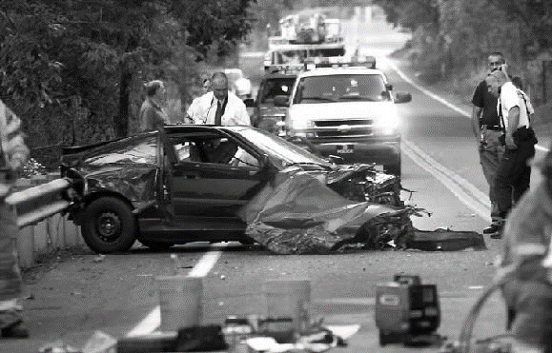

PROBLEM
Driving under the influence of alcohol has affected and killed countless people's lives.
If you drink and drive, not only do you possibly put yourself at risk, but your passengers and pedestrians, and other people, who were on the roads.
Every thirty minutes someone's life is cut short and families are devastated.

Slide 3
The Facts!
As per the National statistics, an average of nearly 12,000 people die every year and an average of nine lakh people get arrested in DWI incidents.
LPG tanker overturns in Kannur, driver booked for drunken driving.-15/12/22
It is a major cause of concern.
Rs. 10,000 and/or up to 6 months imprisonment for the first time offence, and for the second time offence, it's Rs. 15,000 and/or imprisonment of up to 2 years.

Slide 4
HERE’S THE SOLUTION
-Alcohol sensing and automatic braking system

Slide 5
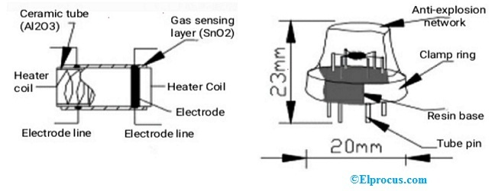
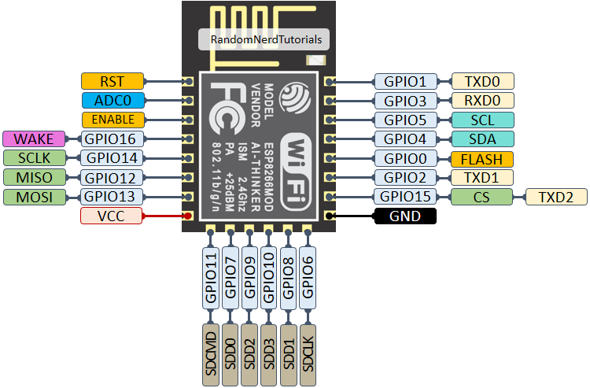
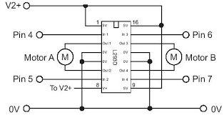
Components

Slide 6
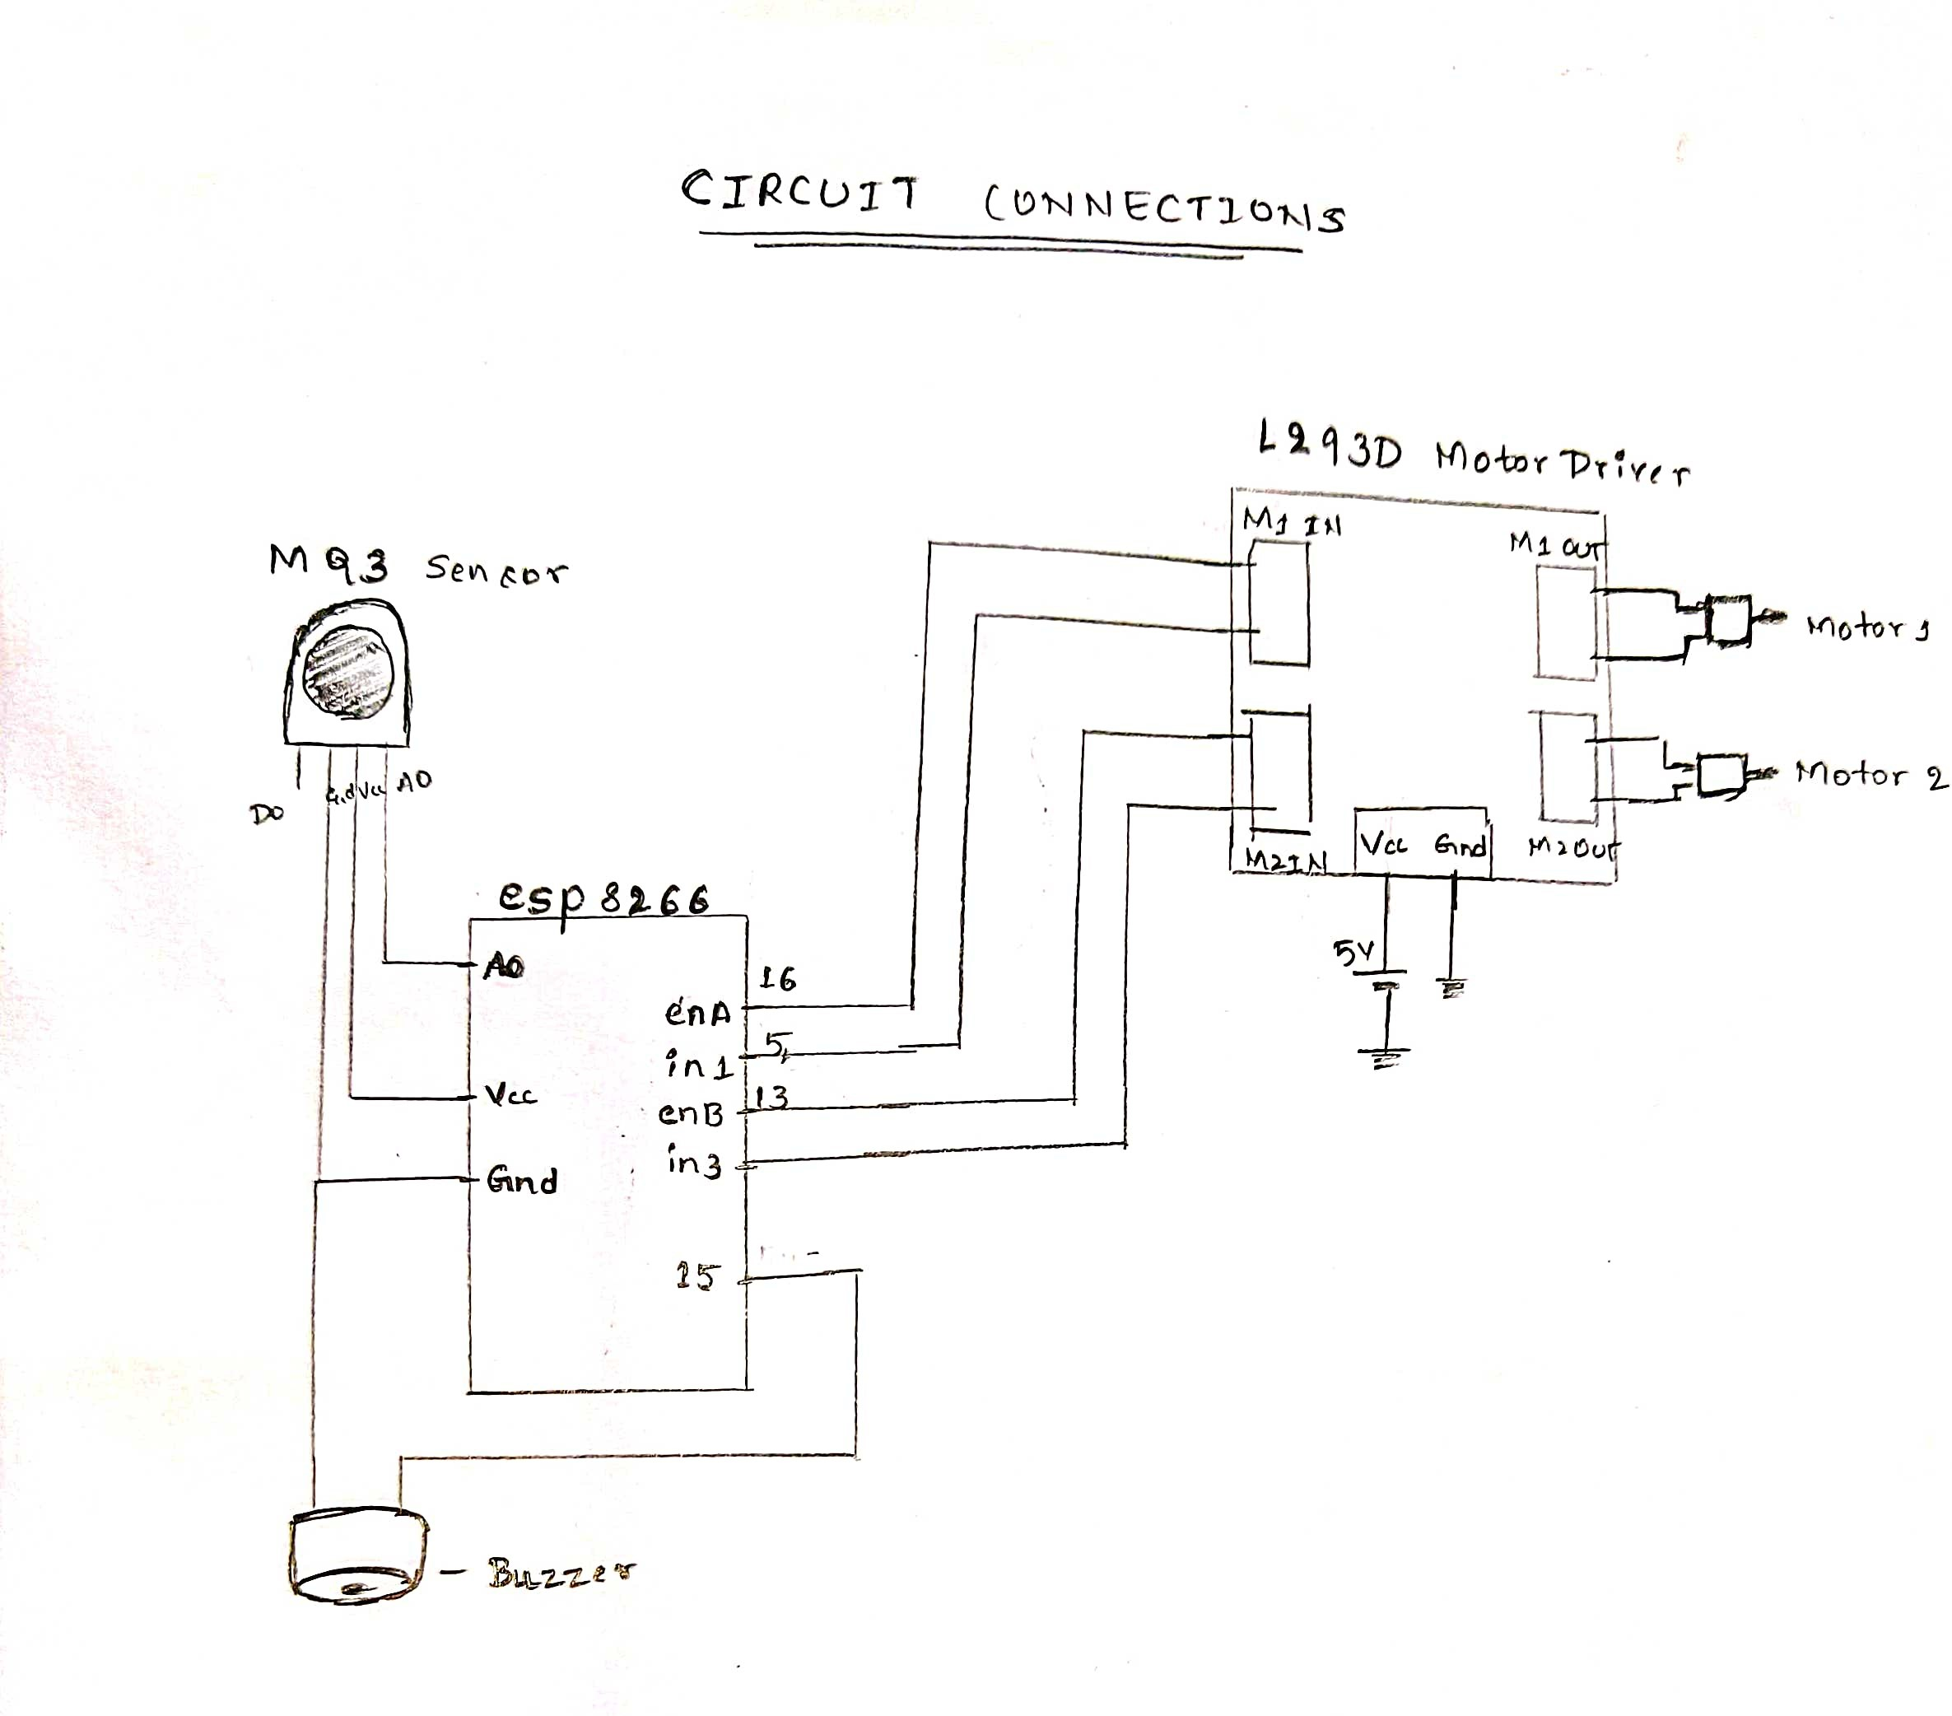
CIRCUIT DIAGRAM

Slide 7
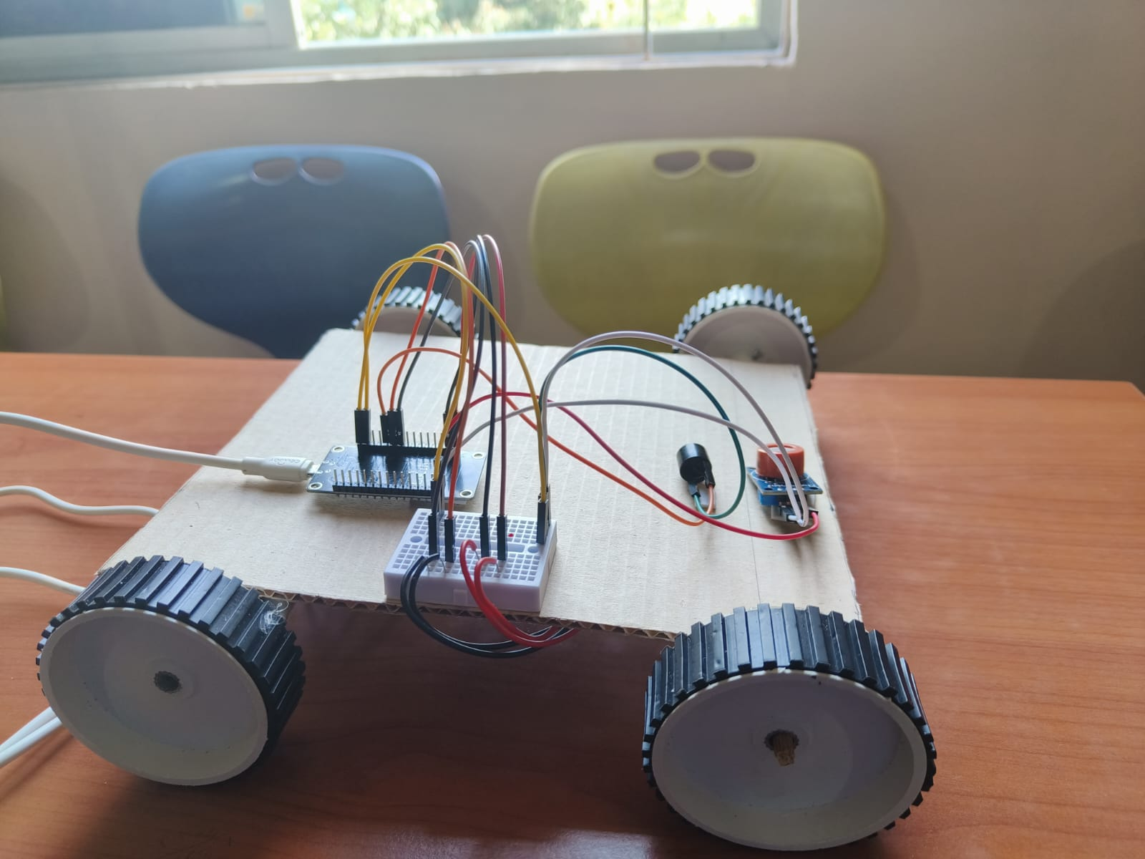
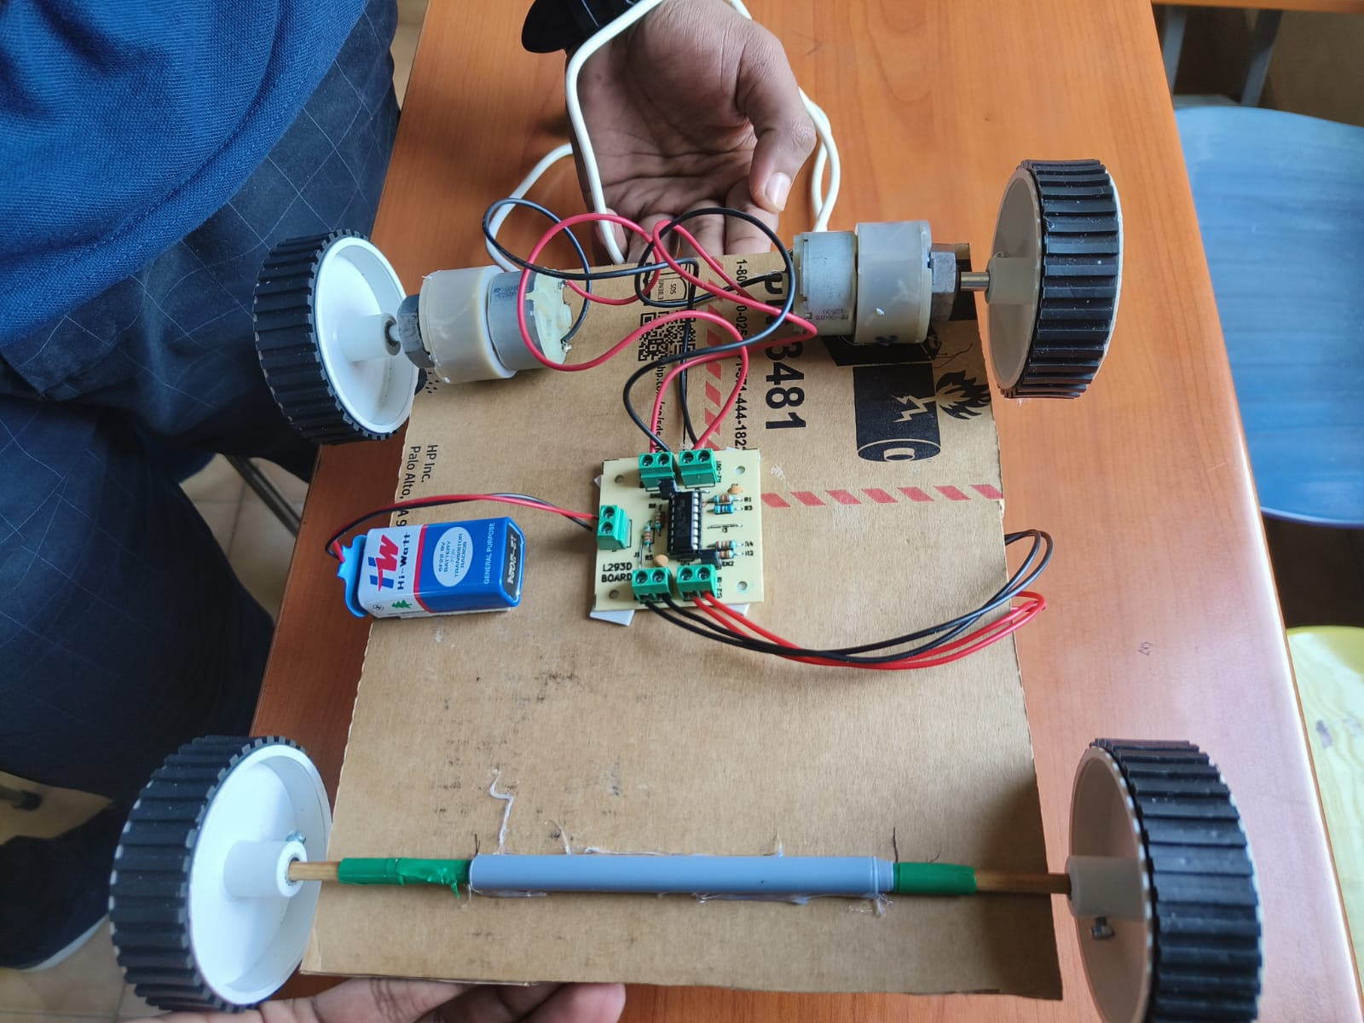
MODEL
FRONT
BACK

Slide 8
WORKING
The alcohol sensor will detect the presence or absence of alcohol in the drivers breathe.
If the presence of alcohol is detected it will send a necessary signal to the esp8622 micro controller and hence detects the presence of alcohol.
The micro controller then will trigger the driver circuit and hence stops the vehicle which prevents the accident
The controller will send the alcohol content data to the cloud and the real time data will be collected and graph will be plotted.
These data can be analyzed and hence can be used for various purposes.

Slide 9
IMPLEMENTATion
The product can be installed in government vehicles and other vehicles like lorrys and other heavy vehicles.
It can also be used in B to B model.
It can be installed in vehicles of high end tech as per the individuals choice.
It can also be implemented and used in various vehicles and other places where alcohol is prohibited

Slide 10
THANK YOU

